Slide 1
Detecting the source of spread in complex networks
Boleslaw Szymanski and Krzysztof Suchecki
RPI, Troy

Slide 2
Plan
Spreading processes and sources
Source search in networks
Pinto-Thiran-Vetterli algorithm
Beyond basic methods

Slide 3
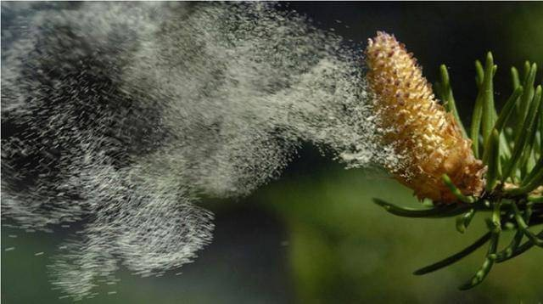



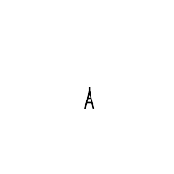
Spreading processess and sources
physical substances
infections
waves
Start small
Become widespread

Slide 4
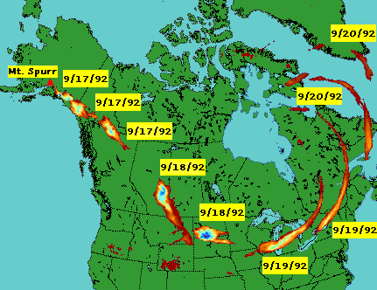
Spreading processess and sources
Is it possible to identify the source ?
If we have full data, it's obviously easy.
The point at which the wave/cloud/infection/etc. appeared earliest is the source.
Usually we don't have full data, only partial:
●
Limited time (only since certain point) Limited scope (only know certain points)
●

Slide 5
Spreading processess and sources
Is it possible to identify the source ?
In deterministic spreading (e.g., waves) in space, this is easy.
t=8
Given D+1 points with time, or just 2 points with direction, we can tell where the source is.
Problems:
t=9
t=3
Stochastic/complex dynamics (epidemics)
Complex space (spreading in atmosphere)
Spreading in network (epidemics, information)
●
t=7
●
●

Slide 6
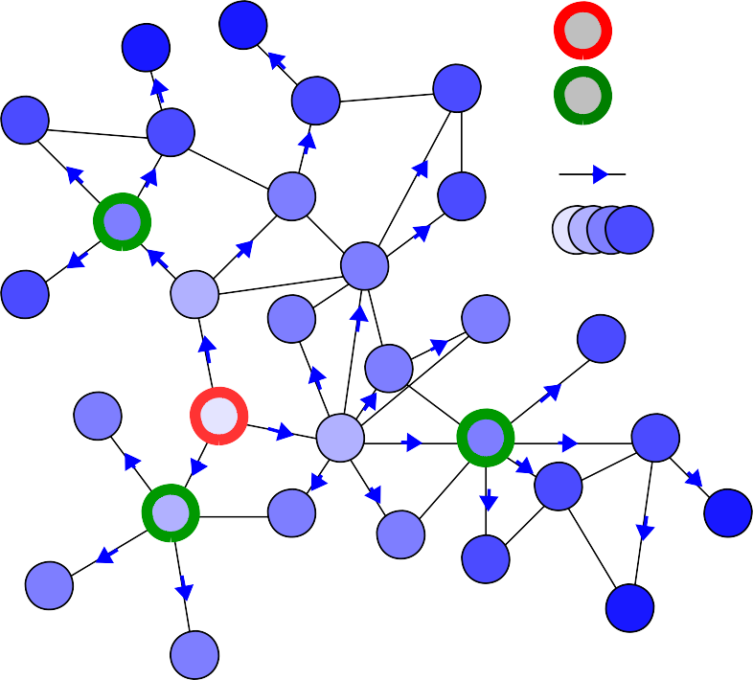
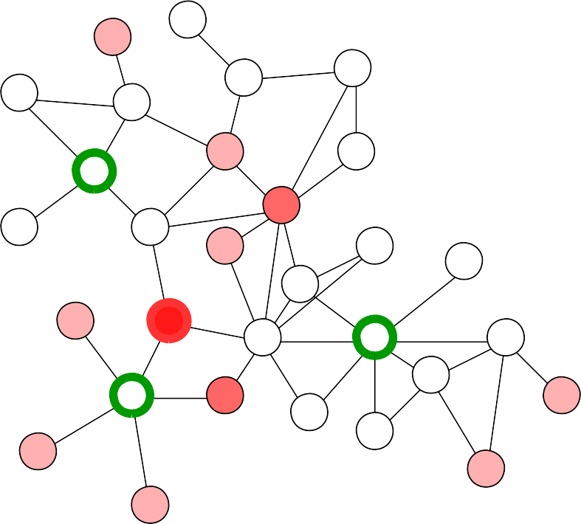
Source search in networks
source
Similar “triangulation” approach could be used in networked environment.
each observer has a “circle” of radius equal to time of observation
where all “circles” intersect is the source
observer spreading time
t=2
t=2
t=1
t=2
t=2
t=1

Slide 7
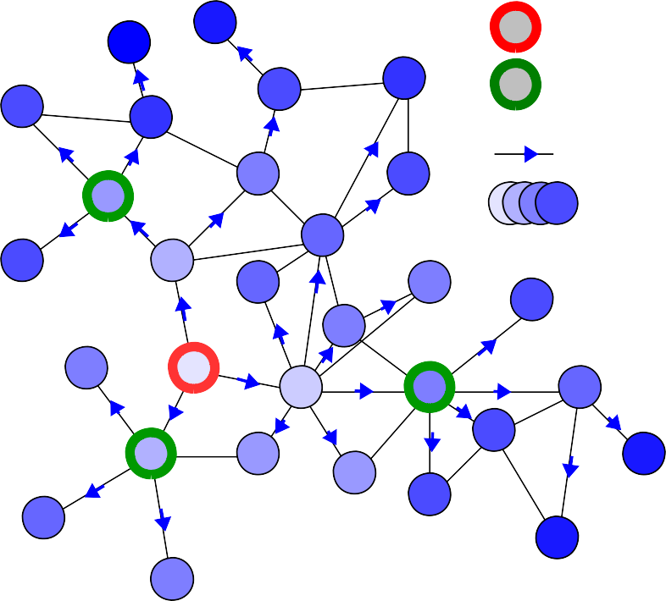
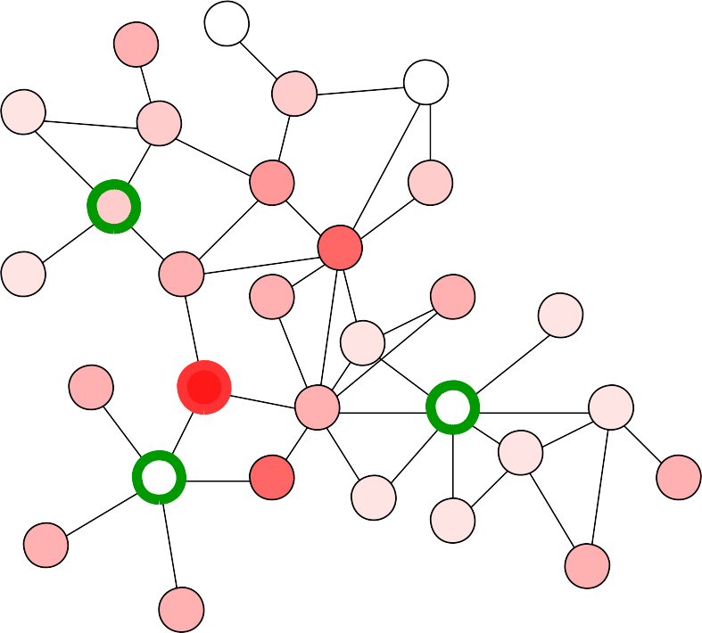
Source search in networks
source observer spreading
time
If the process is stochastic, then the times are random variables and sharp-defined “circles” become blurry distributions.
t =4
P(s|t )
2
i
Probability of given node being source conditional on observation time t at observer i
i
t₃=5
t₁=3
t ~4
2
Note: on the right, the sum of probabilities from different observers are added up – this is not overall probability for given node to be source
t ~5
3
t ~3
1
P(s|t )+P(s|t )+P(s|t )≠P(s|t ,t ,t )
1 2 3 1 2 3

Slide 8
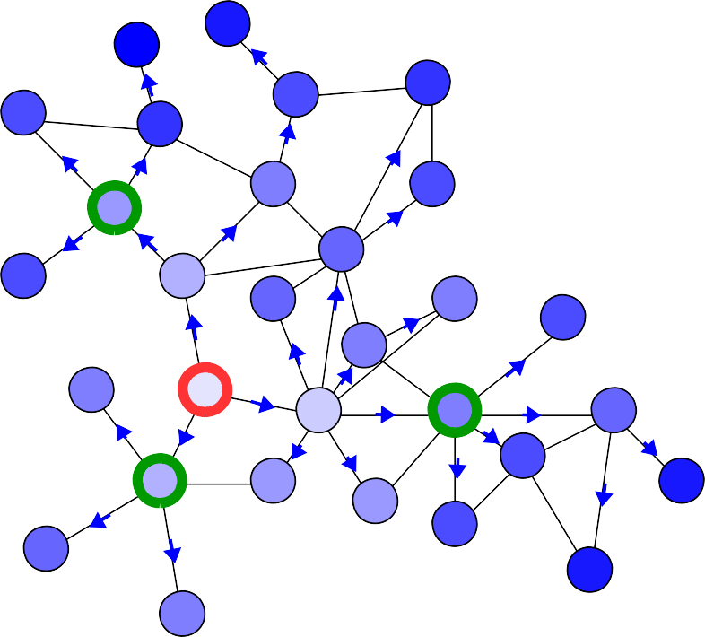
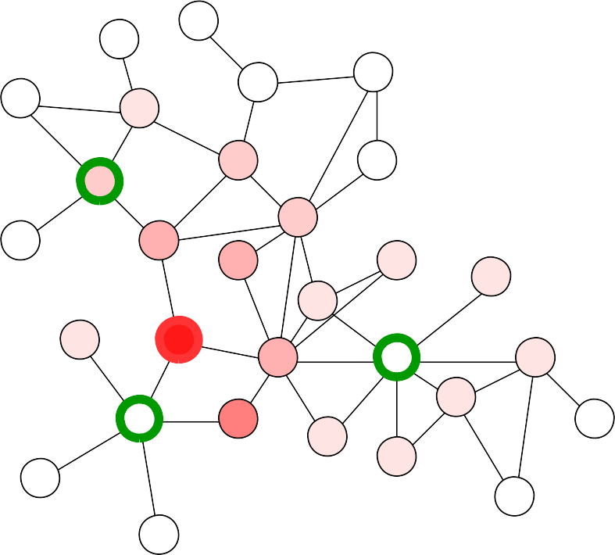
Source search in networks
source
If we look at all observers together, could we determine the overall probability ?
P( s|t ₁ , t ₂ , t ₃)≡P (s|t )
If we have this, we could determine the most likely source.
observer spreading time
t =4
2
t₃=5
t₁=3
t ~4
2
t ~5
3
t ~3
1

Slide 9
Source search in networks
Bayes' Theorem:
P( s|t )=P (t|s) ^{P( s)}
P(t )
In other words:
If we can calculate distribution of times given a source, we can calculate distribution of probability of being source given observation times.
To calculate P(t|s) we need to know something about the spreading process.
With this, we can calculate P(s|t) if we know P(t|s) – distribution of observed times if given node would be source
P(s) – usually we know nothing about which node could be real source, so we assume uniform 1/N distribution over all nodes
P(t) – we can calculate as
P(t )=∑ P(t , s )=∑ P( s) P(t|s)
s s
Which we will need only for single value of t (the one that was observed)

Slide 10
Source search in networks
The better model we have for spreading, the more accurately we can calculate P(t|s), and thus make more accurate calculation of P(s|t) and find the source.
●
Susceptible-Infected(-Recovered) model, created to describe spread of infectious diseases, is one of most commonly used to describe complex behavior, by reducing it to randomness.
Infection rate β
I S
I I
Recovery rate γ
β
I
γ R
●
Diffusion/random walks, could be used to describe spread that conserves some “mass”
Random movement rate α
α α
●
Assume normally distributed delays on edges this is not really accurate model for anything, but unlike others, is possible to precisely calculate P(t|s) analytically
- could be used to approximate other models
Delays normally distributed t2-t1 ~ N(μ,σ)
t1 t2

Slide 11
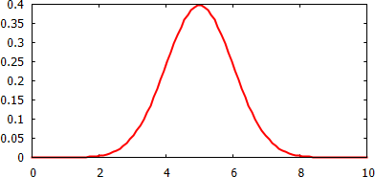
Source search in networks
Assume:
●
normal delays on links t ~N(μ,σ)
ij
tree topology ← unfortunately necessary for analytical solution
assuming
●
t =t +t
Mean: μ =μ
1 01
IID delays
=μ
=2μ
=2μ
2 01 12
t
t
43
μ =μ +μ
12
t =t +t
2 01 12
t =t
1 01
t
t
04
3 04 43
μ =μ +μ
01
3 04 43
Variance:
σ² =σ²
=σ²
1
01
σ² =σ² +σ²
=2σ²
=2σ²
2
01 12
Sum of normally distributed variables t =
σ² =σ² +σ²
ij
3
04
43
= normally distributed variables t
i
( )
1
(t _{i}−μ_{i})
2
P(t_{i})=
√2 π σ_{i}
exp −
2
2
2 σ_{i}

Slide 12
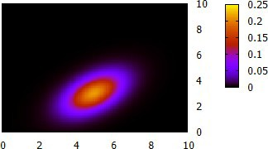
Source search in networks
Assume:
●
normal delays on links t ~N(μ,σ)
ij
tree topology ← unfortunately necessary for analytical solution
●
t =t +t
2 01 12
t
Mean: μ=?
t
43
12
t =t +t
t =t
1 01
t
t
04
3 04 43
01
Covariance: Σ=?
Take all times – multivariate normal distribution
1
P(⃗t )=
exp −¹ (⃗t −⃗μ)^{T} Σ⁻¹( ⃗t −⃗μ)₎
t
2
Note: times may be correlated !
t
1

Slide 13
Source search in networks
[ ] [ ]
Mean:
μ|P_{s1}|
2
Mean is just length of path P
⃗μ= μ|P_{s 2}| =μ 1
si
from source to observer times mean delay on link
μ|P_{s 3}|
2
o
1
Covariance:
Covariance of random random variables made of sum of random variables is just the part that repeats in both – path overlap
o
3
o
2
]
[ ]
|P_{s 1}| |P_{s 1}∩P_{s 2}| |P_{s 1}∩P_{s 3}|
2 | 1 | 0
1 | 1 | 0
0 | 0 | 2
σ² =σ ²
|P_{s 3}∩P_{s 1}| |P_{s 3}∩P_{s 2}| |P_{s 3}|
Note: P here is path between observers i and j, not probability
ij

Slide 14
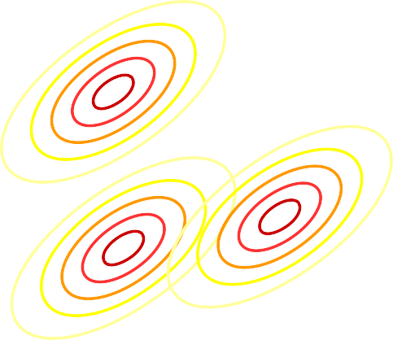
Source search in networks
We know how to calculate P(t|s) as multivariate normal distribution under few assumptions.
We can get what is probability P(t|s) for the observed time and calculate P(t)
t o
2 1
o
o
3
best fit ! (highest P(t|s))
2
Note: illustration only, distributions not according to network shown on the right
t
1
Given P( s|t )=P (t|s) ^{P( s)}
and P(s) (a priori), P(t) (from P(t|s) and P(s))
P(t )
We know that node s with highest P(s|t) is the one where P(t|s) is highest (what distribution fits the real data best)

Slide 15
Source search in networks
We know how to calculate P(t|s) as multivariate normal distribution under few assumptions.
We can get what is probability P(t|s) for the observed time and calculate P(t)
t o
2 1
o
o
3
2
highest P(s|t)
Note: illustration only, distributions not according to network shown on the right
t
1
We can also calculate P(s|t) and thus calculate how likely it is for each node to be source.
(distribution of P(s|t) on nodes)

Slide 16
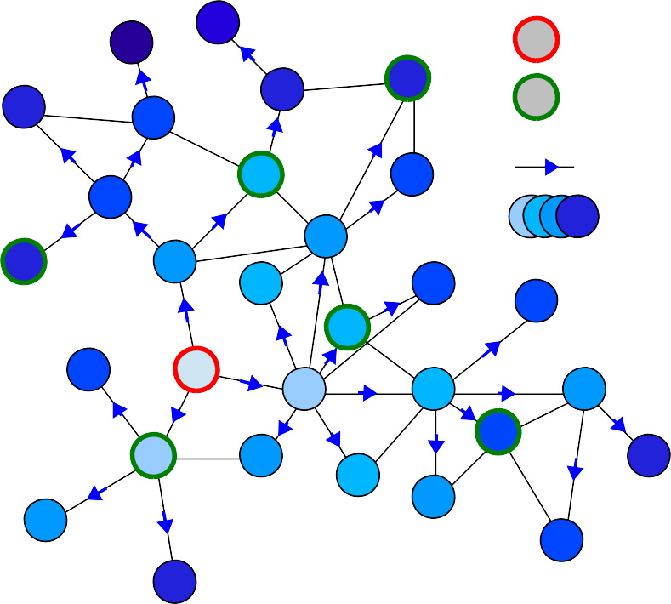
Pinto-Thiran-Vetterli algorithm
Known:
source observer spreading
time
Network topology
Times when spreading arrived at observers
Mean time it takes to infect along a single link
Variance of that time
t=15
●
●
t=8
●
t=17
t=7
●
Want to know
●
True source of the spread
t=12
t=3
Assumes
●
Network is a tree (or approximates as such)
●
Normally distributed delays on links
Not known
●
When spread started (not necessarily at t=0)
P.C. Pinto, P. Thiran, M. Vetterli, “Locating the source of diffusion in large-scale networks”, Physical Review Letters 109, 068702 (2012)

Slide 17
Pinto-Thiran-Vetterli algorithm
Issue: network is not a tree
Solution: make a tree out of it !
o
Since spreading process uses fastest path, it usually means the shortest topologically.
0
o
o
1
2
Use Breadth-First Search to make a tree (BFS tree) rooted at suspected source.
s
Suspected source
Note: each suspected source may have different BFS tree, unless original network is actually a tree.
Which link to take ?
Shortest paths are not unique, so we have to take one of the trees. Different trees may give different results.

Slide 18
Pinto-Thiran-Vetterli algorithm
Issue: we don't know the “zero” time (when spread started)
Solution: look at relative times only – use one observer as reference (e.g. observer 1 becomes 0 (reference), 2→1, 3→2)
Mean: use time relative to reference
o
[ ]
[ ]
0
⃗μ=μ |
^{P}s 1 ^{P}s 0
|−| |
=μ
−1
|P |−|P |
0
o
s 2 s 0
2
o
Covariance: use paths anchored at reference, not suspected source
1
]
[ ]
Note: since the correlations are correct for tree only, for non-trees it's only approximation. Using closest observer (with smallest time) as reference minimizes this error for non-tree networks.
=σ²
1 1
1 4
|P₀₂∩P₀₁| |P₀₂|
reference observer also introduces randomness, which is added or substracted from relative results (depend on situation)

Slide 19
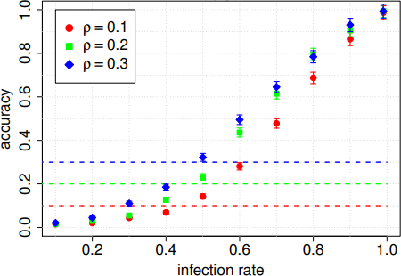
Pinto-Thiran-Vetterli algorithm
Performance of PTV algorithm:
Only really works when infection rate is high → so called propagation ratio μ/σ.
High propagation ratio – process is more deterministic. Low propagation ratio – process is more stochastic.
Can't expect to find a needle in a haystack with few measurement points, but still performs reasonably well if the process isn't too random.
Note: broken horizontal lines show accuracy of naive method that says that observer with lowest time is actual source, accuracy is equal density of observers then

Slide 20
Beyond basic methods
What can be we improve ?
●
Make it faster (because it's slow O(N³) or worse) Don't approximate with a tree
Use other distribution than normal Adapt for directed, weighted network
Early estimation of source using yet silent observers
●
●
●
●
Note:
red – not attempted or done, hard to solve yellow – only approximation done
green – done
black – under investigation

Slide 21
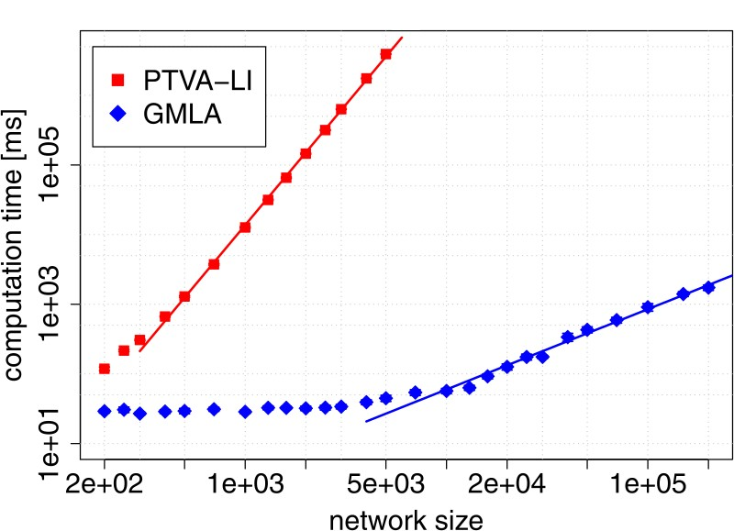
Beyond basic methods
●
Make it faster (because it's slow O(N³) or worse)
In particular O(N·(N²+K³)), where N is network size and K is number of observers. If K~N, then it is as bad as O(N⁴) !
possible to make it
~10000 times faster for networks of ~1000 nodes
Feasible to calculate for networks of even millions of nodes (will not take 1000 years)
Cause:
- calculating likelihood score for each node
using potentially large number of observers, requiring large tree and matrix operations
Solution:
use greedy gradient (limits node to calculate score for)
use only closest (smallest arrival time) observers to calculate likelihood

Slide 22
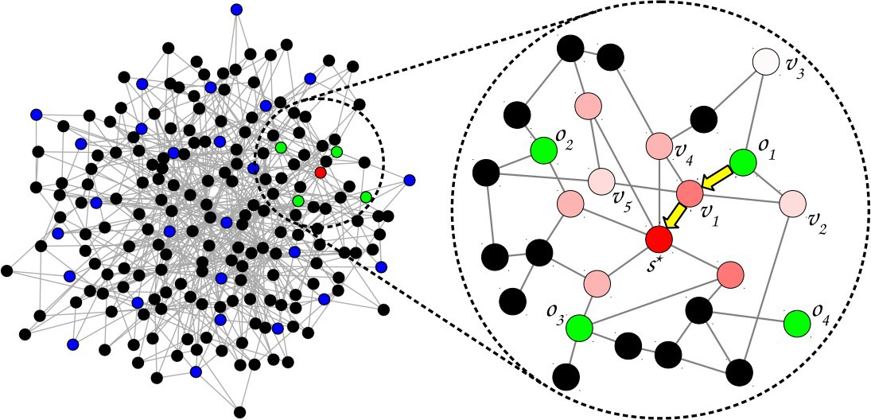
Beyond basic methods
●
Make it faster (because it's slow O(N³) or worse)
Only some observers taken into account (green)
Solution:
use greedy gradient (limits node to calculate score for)
use only closest (smallest
arrival time) observers to calculate likelihood
Note: accuracy does not decrease in most situations, sometimes even increases !
Not all nodes have score calculated (only pink/red)
Gradient Maximum Likelihood algorithm
R. Paluch, X. Lu, K. Suchecki, B.K. Szymański, J.A. Hołyst, “Fast and accurate detection of spread source in large complex networks”, Scientific Reports 8, 2508 (2018), doi: 10.1038/s41598-018-20546-3

Slide 23
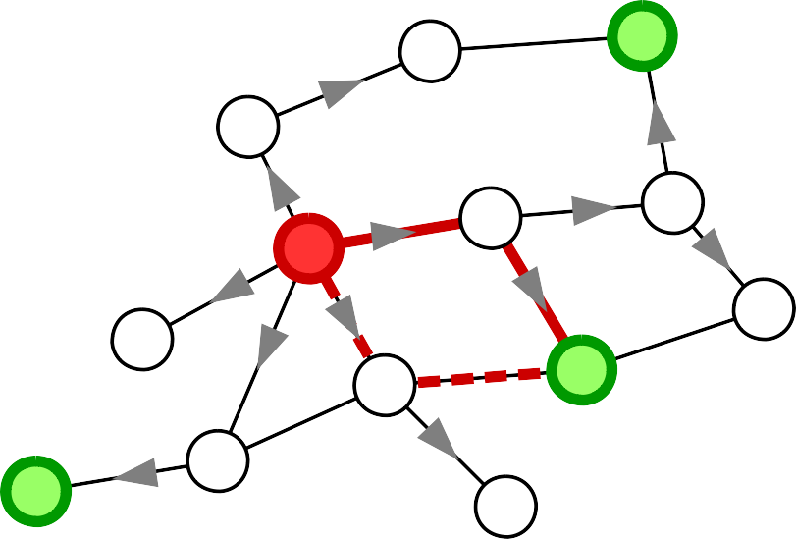
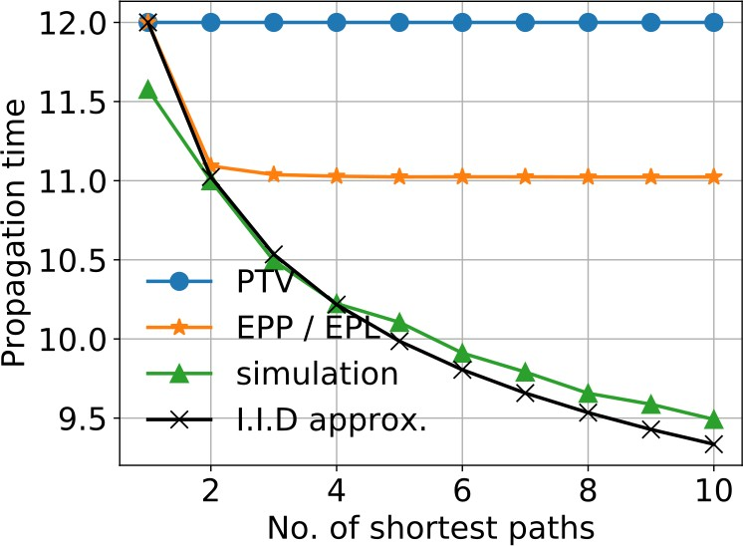
Beyond basic methods
o
Don't approximate with a tree
2
●
Multiple paths change mean time, even if they have same length
A
s
B
C
D o
1
o
3
t =min(A+B, C+D)
2
⟨t ⟩=⟨min(A+B, C+D)⟩≠min(⟨A+B⟩, ⟨C+D⟩)=2μ
2
Multiple paths can be taken into account when calculating expected mean times μ. Issue: correlations between them (which change mean of minimum)
Mean of the minimum of two IID random variables is smaller than mean of that variable.

Slide 24
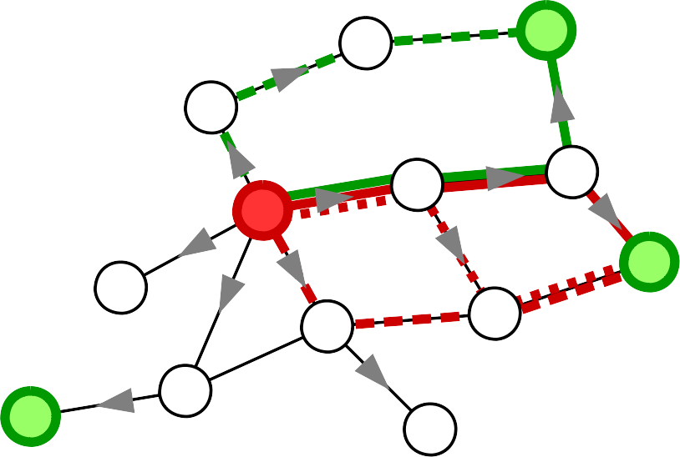
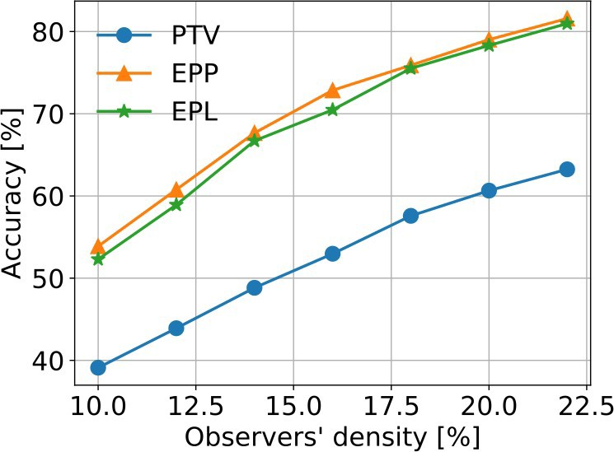
Beyond basic methods
o
Don't approximate with a tree
2
●
No exact analytical solutions – only approximations possible.
s
Mean:
> Exact value for least correlated single pair.
> As if paths are uncorrelated
o
1
Covariance:
> Equiprobable Paths (EPP) – assume it's equal to mean of covariances of all path pairs in the two sets.
> Equiprobable Links (EPL) – assume
it's equal to overlap between sets of links of both path sets.
o
3
Ł.G. Gajewski, K. Suchecki, J.A. Hołyst, Multiple propagation paths enhance locating the source of diffusion in complex networks, Physica A 519, 34-41 (2019),
doi: 10.1016/j.physa.2018.12.012

Slide 25
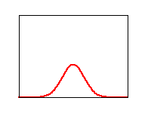
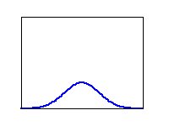
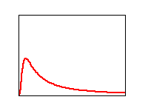
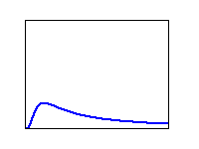
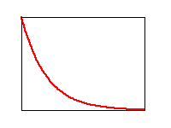
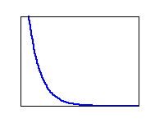
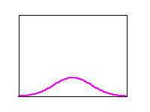
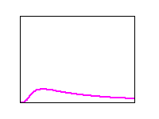
Beyond basic methods
●
Use other distribution than normal
Idea is obvious, but solution is hard:
●
If sum of 2 variables is from different distribution than each, number of variables can affect the shape of distribution, not only parameters
assuming stable distribution (sum comes form same distribution) mean of sum will be sum of means, but how do other parameters of distribution change ?
Extra issue: analytical stable distributions have infinite (Levy) or undefined
(Cauchy) mean !
Normal Stable Other
●
+
+ +
?
???

Slide 26
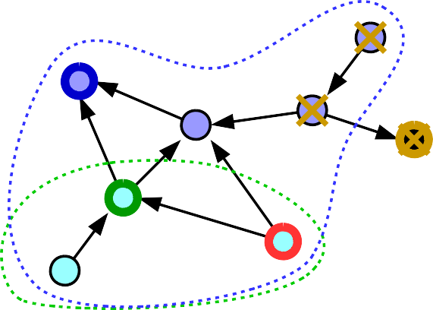
Beyond basic method
●
Adapt for directed, weighted network
If the probability of infection depends on the link ? → weighed networks
o
0
If the link is one-sided (e.g. only reader of infecfed e-mail can catch computer virus)
→ directed networks
o
o
2
1
s
Not every observer will report any time, since parts of network may be unreachable from certain source
o
0
o
o
2
1
s
Information where spread arrived at all gives constrains on where the source can be (blue, green observers) or can't be (yellow observer), before we even consider time distribution

Slide 27
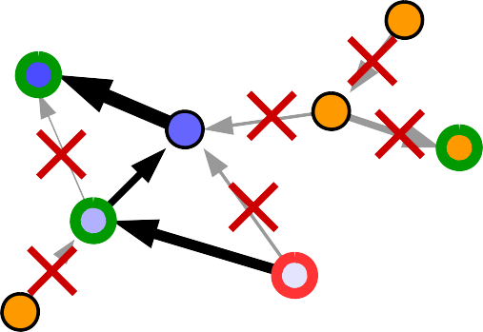
Beyond basic method
●
Adapt for directed, weighted network
active observers
Weights on links mean BFS will be according to shortest mean time, not topological distance.
They also span only part of network reachable from given node in directed networks.
Only active observers are taken.
o
0
o
o
2
1
s
passive observer
(no observation)
Mean: path lengths become sums of delays on paths
[ ]
|P |−|P |
→ μ( P )−μ( P )]
μ=μ
s 1
s 0
[
⃗
si s 0
|P |−|P |
s 2 s 0
Variance: can't use paths to/from reference because they are always from source towards observer – use source→observer paths instead; variance depends on path
]
→ σ ( P ∩P / P )+ σ² ( P /( P ∪P ))]
[
2
|P₀₂∩P₀₁|
|P₀₂|
si sj s 0 s 0 si sj

Slide 28
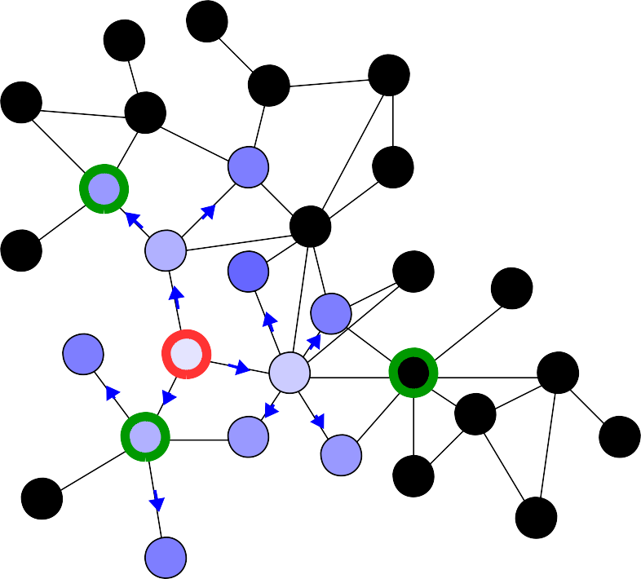
Beyond basic method
●
Early estimation of source using yet silent observers
A contagion started spreding out !
We have this situation now, we know 2 places where it already reached. Is this all information we can use to detect the source ?
t =4
2
t =?
What about the 3rd place, where it did not reach yet ?
3
t₁=3
Can we use that information to increase the chances of succesfully finding the source early on ?
2 active observers
passive observer
(no time measurement yet)
Yes, we can.

Slide 29
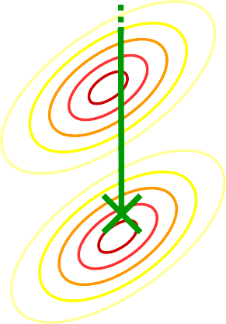
Beyond basic method
●
Early estimation of source using yet silent observers
If passive observers are not infected yet, it means that time to reach that observer is larger than largest observed time.
t =4
2
t
t >4
3
3
t₁=3
measured t
2
measured t Effectively, measurement is not a point, but a part of space
t
2
1,2
of arrival times (here, a line because we have 1 passive observer, but for more observers it's more dimensional)
Need to integrate over passive times > max time

Slide 30
Beyond basic method
●
Early estimation of source using yet silent observers
t
Possible approximations:
4
Integrate over this area
●
Independent passive observers
*|
∏
t
P(t s)= P( t |
s)
P(t_{i} >t_{max} )
max
a
i passive
●
Mutually independent passive observers
t
t
∏
max
3
*
|
P(t s)= P( t |
s)
P(t >t |t )
a
i passive
i max p
Integrating over an arbitrary cut of correlated multivariate normal distribution (gaussian orthant problem) is a hard problem – closed form analytical solutions exist only for up to 3 dimensions
●
Numerical solutions
Can be too expensive computationally

Slide 31
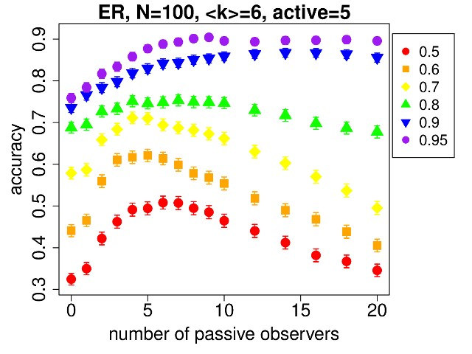
Beyond basic method
●
Early estimation of source using yet silent observers
Does it actually work ?
Why can taking too many decrease the accuracy ?
- since we assume independent, they don't take correlations into account and if they outnumber real observers, they shift “best” towards the “uncorrelated best”
- mutually independent passive observers approximation should solve that (at least partially)
Results for independent passive observers approximation show that it does, but only if we take not too many of them.

Slide 32
Beyond basic method
Other issues or extensions:
Using different spread model, where spreading is not certain (for example full SIR with recovery)
Where to put observers in a network if we want to
maximize accuracy ?
Inverse: how to design spreading method to hide the source ?
Other methods of finding source than maximum likelihood
●
●
●
●

Slide 33
Thank you
P.C. Pinto, P. Thiran, M. Vetterli, “Locating the source of diffusion in large-scale networks”, Physical Review Letters 109, 068702 (2012), doi: 10.1103/PhysRevLett.109.068702
R. Paluch, X. Lu, K. Suchecki, B.K. Szymański, J.A. Hołyst, “Fast and accurate detection of spread source in large complex networks”, Scientific Reports 8, 2508 (2018), doi: 10.1038/s41598-018-20546-3
Ł.G. Gajewski, K. Suchecki, J.A. Hołyst, “Multiple propagation paths enhance locating the source of diffusion in complex networks”, Physica A 519, 34-41 (2019), doi: 10.1016/j.physa.2018.12.012
R. Paluch, B.K. Szymański, J.A. Hołyst, “Efficient observers for source localization in complex networks: the state-of-the-art and comparative study”, Future Generation of Computer Systems, 112(11):1070-1092 June 22, 2020.
Y. Lytkin, R. Paluch, Ł. Gajewski, K. Suchecki, K. Bochenina, B.K. Szymanski, J.A. Hołyst, “How much information is in silence”, in preparation

